Slide 1
BT201
Biochemical Process Calculations
Tutorial
03/11/2022

Slide 2

Problem 1

Slide 3
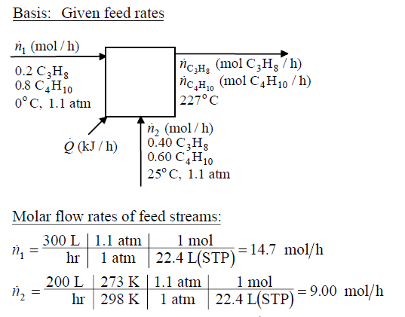

Slide 4
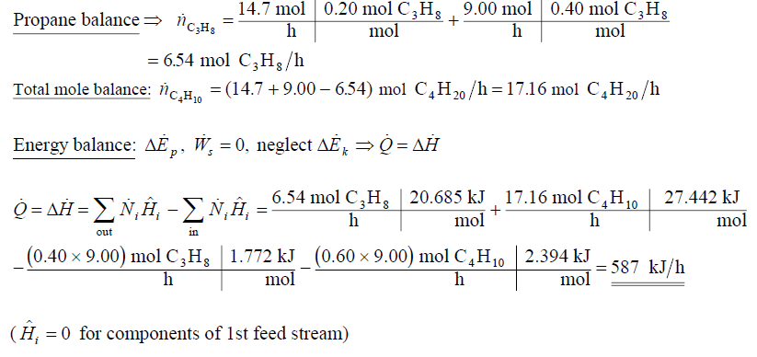

Slide 5

Problem 2

Slide 6
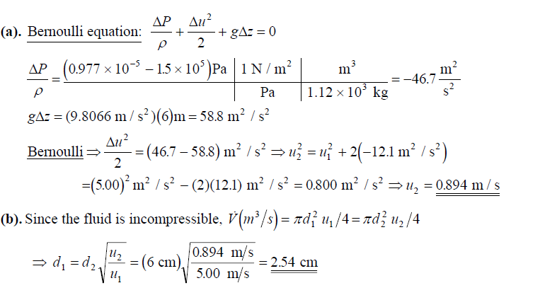

Slide 7

Problem 3

Slide 8
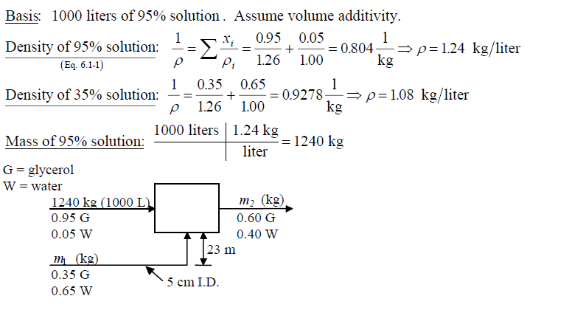

Slide 9
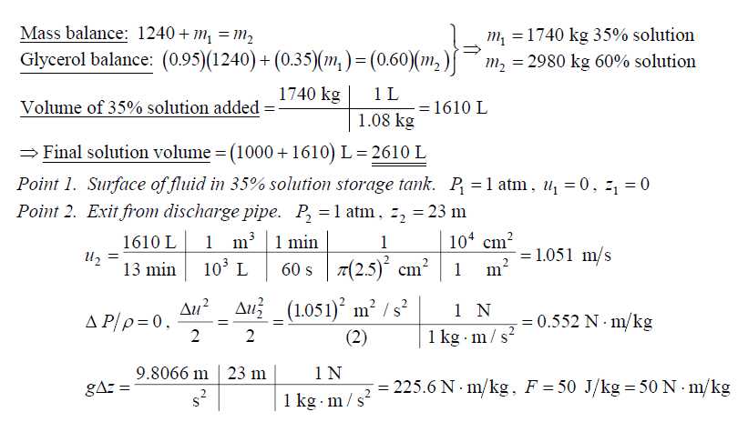

Slide 10
